Slide 1
Juvenile Chinook Salmon (Oncorhynchus tshawytscha) occupy the Yolo Bypass in relatively high numbers during an extreme drought – R code
Pascale Goertler, DWR
http://www.water.ca.gov/iep/docs/IEP_Vol28_1-.pdf

Slide 2
R graphics in ggplot2()
Edward Tufte, the Visual Display of Quantitative Information
Introduction to ggplot2()
Popular resources for ggplot2()
Rstudio
Figure 3: stacked bar plot
Figure 5: 3-combined plots

Slide 3
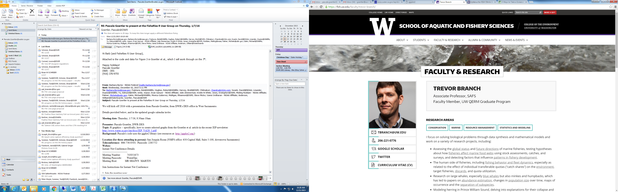
Beautiful graphics in R

Slide 4
Principles of graphical excellence
Beautiful graphics in R

Slide 5
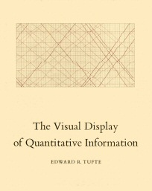
Principles of graphical excellence
Beautiful graphics in R
http://www.edwardtufte.com/tufte/index

Slide 6
Principles of graphical excellence
Well-designed presentation of interesting data
Complex ideas communicated with clarity, precision, and efficiency
Greatest number of ideas in shortest time with least ink in smallest space
Nearly always multivariate
Requires telling the truth about the data

Slide 7

Principles of graphical excellence
Original plot by Minard (1861)
Tufte (2001) The visual display of quantitative information
Lie factor and exaggeration
Chart junk
Data density index
Maximize data:ink ratio
Erase non-data ink

Slide 8
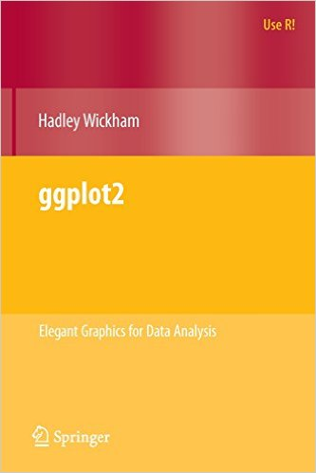
R graphics in ggplot2()
http://ggplot2.org/
Authors of ggplot2():
Hadley Wickham, Winston Chang
http://had.co.nz/
Tools for model visualisation: classification boundaries,
clustering and ensembles of linear models
DescribeDisplay, a package for recreating GGobi graphics in R
rggobi for fluidly moving data and metadata between R and GGobi
plyr, a package that generalizes and standardizes the apply
family of functions for summarizing data
testthat, a friendly unit testing framework for R
profr, an alternative visualization for profiling data
reshape for flexibly restructuring data in R

Slide 9
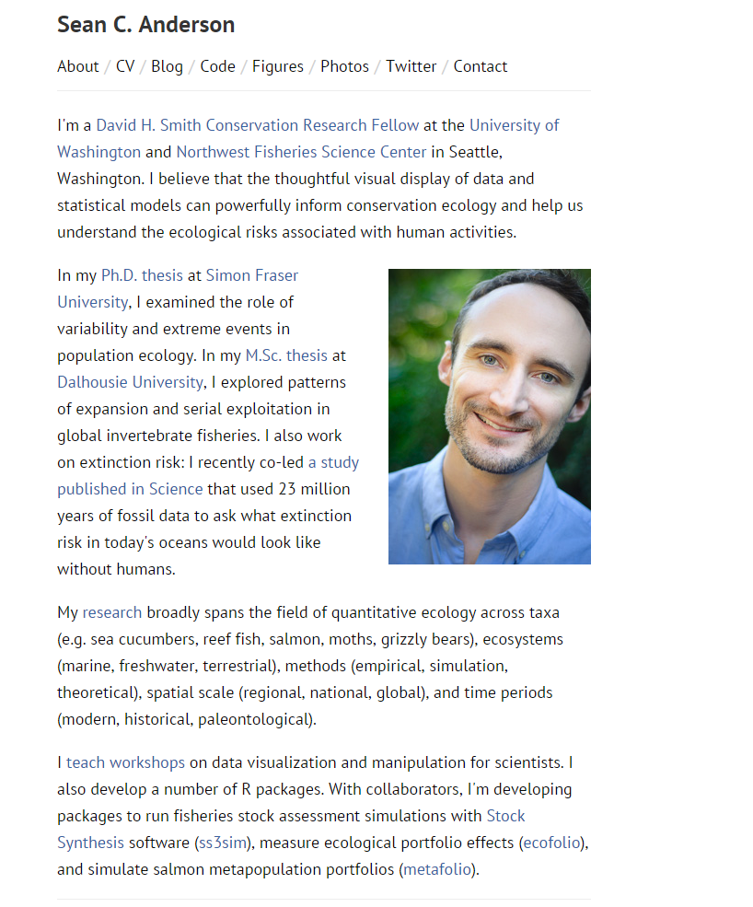
R graphics in ggplot2()
Beautiful graphics in R
http://seananderson.ca/ggplot2-FISH554/

Slide 10
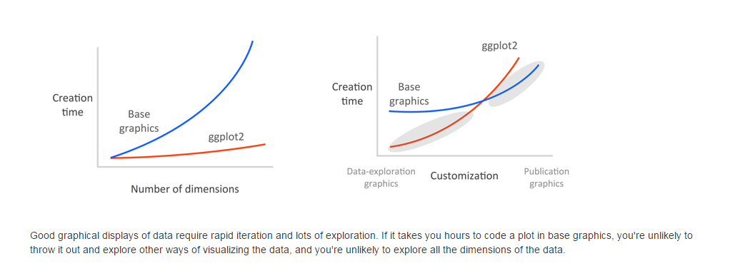
R graphics in ggplot2()
Recommend ggplot for rapid data exploration
and basic graphics for polished and fully customized plots for publication
http://seananderson.ca/ggplot2-FISH554/

Slide 11
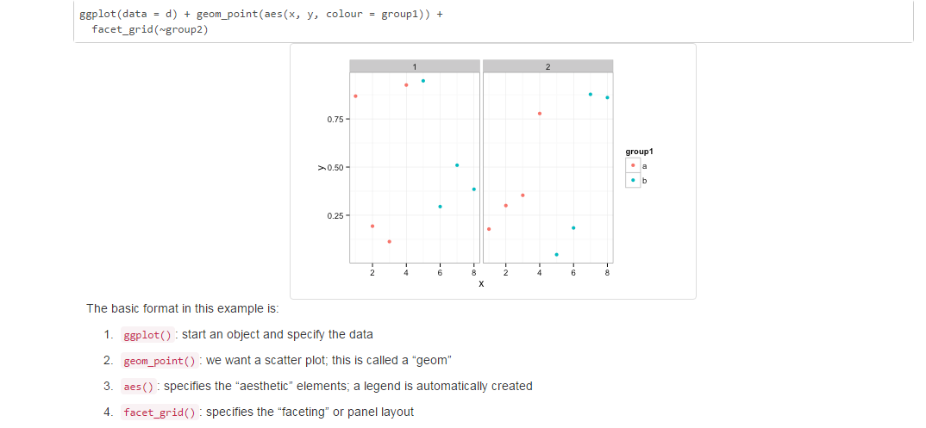
R graphics in ggplot2()
http://seananderson.ca/ggplot2-FISH554/

Slide 12
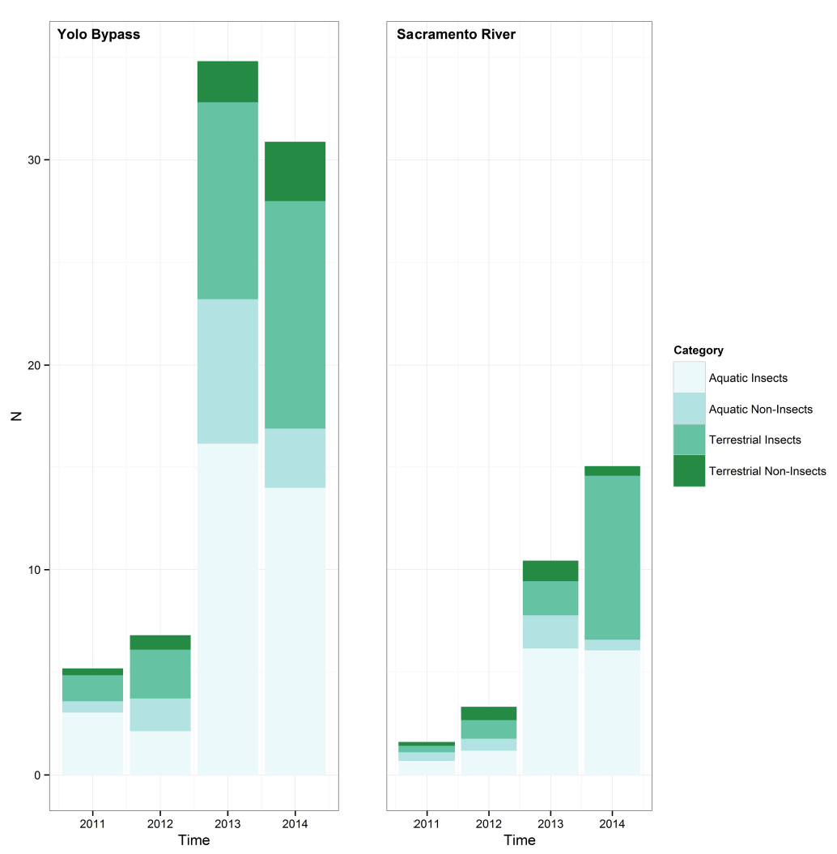
R studio
https://www.rstudio.com/

Slide 13
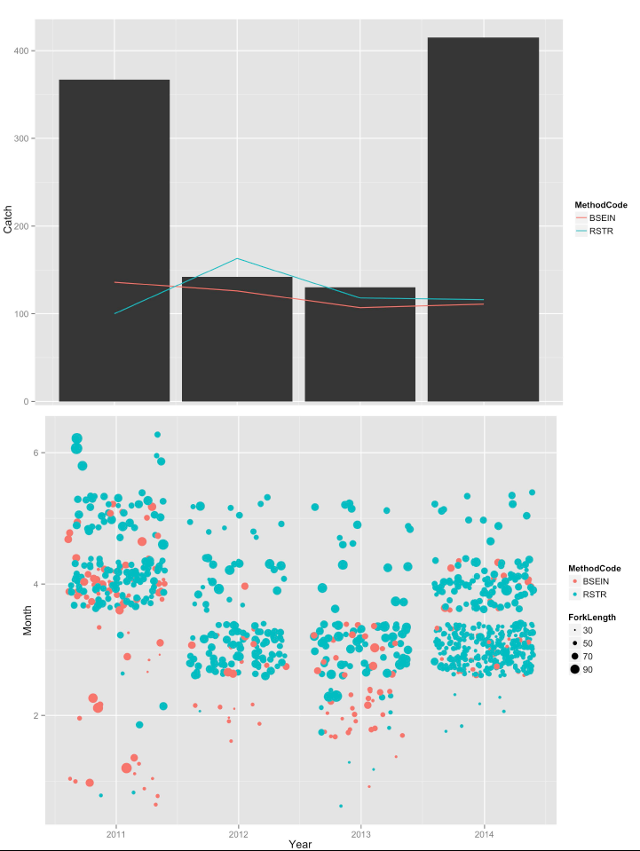
1
2
3

Slide 14
> D
Year Catch Method Effort
2011 367 BSEIN 268
2011 0 RSTR 105
2012 139 BSEIN 246
2012 0 RSTR 172
2013 130 BSEIN 233
2013 0 RSTR 118
2014 415 BSEIN 225
2014 0 RSTR 116
Data
e<-ggplot(D) +
geom_bar(aes(x=Year, y=Catch), binwidth=1, position="stack", stat="identity") +
geom_line(aes(x=Year, y=Effort, colour=Method))

Slide 15
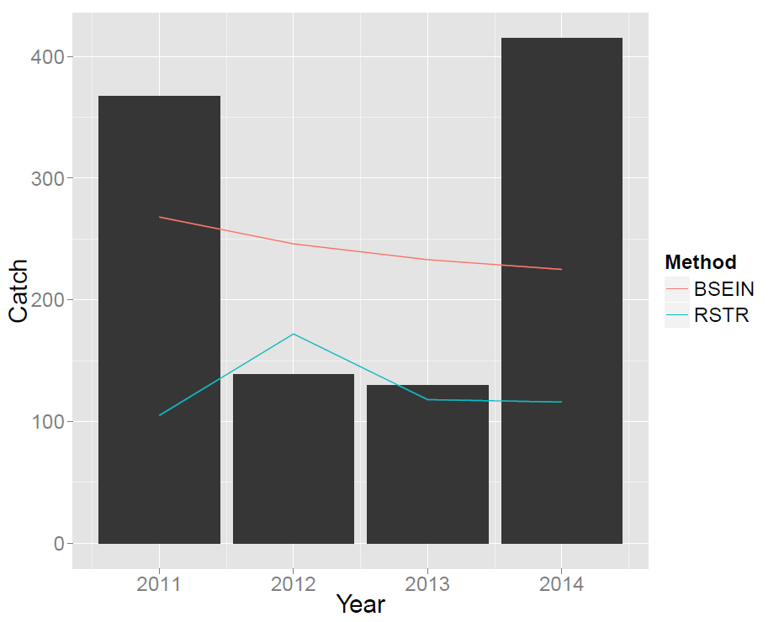
Data
e<-ggplot(D) +
geom_bar(aes(x=Year, y=Catch), binwidth=1, position="stack", stat="identity") +
geom_line(aes(x=Year, y=Effort, colour=Method))

Slide 16
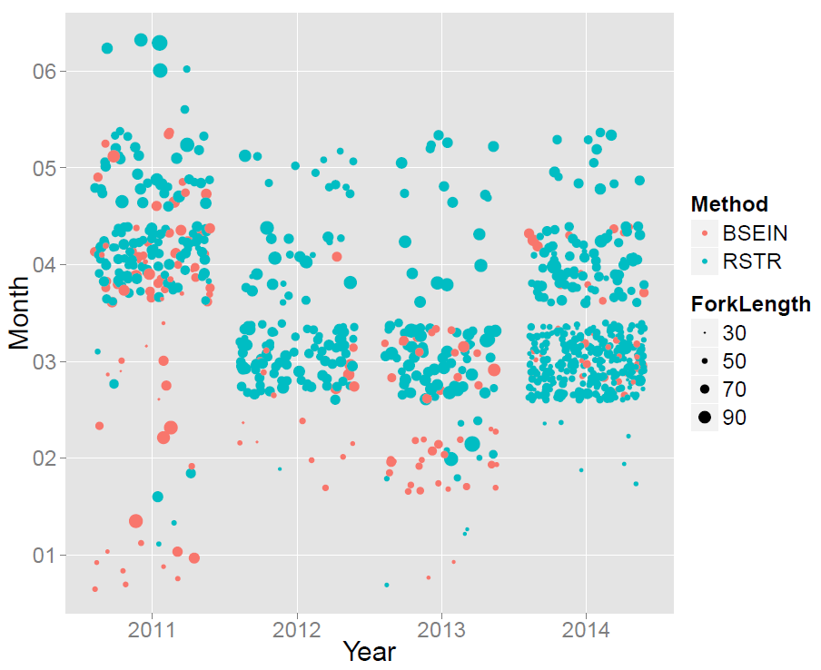
a<-qplot(Year, Month, geom="jitter", data = IEP, colour=Method, size=ForkLength)

Slide 17
a<-qplot(Year, Month, geom="jitter", data = IEP, colour=Method, size=ForkLength)

Slide 18
e<-ggplot(D) +
geom_bar(aes(x=Year, y=Catch), binwidth=1, position="stack", stat="identity") +
geom_line(aes(x=Year, y=Effort, colour=Method))
a<-qplot(Year, Month, geom="jitter", data = IEP, colour=Method, size=ForkLength)
tiff(filename="IEP_Chin_final4.tif", units="in", bg="white", height=15, width =10, res=750, pointsize=10)
vp1 <- viewport(width = 1, height = 0.52, x=0.5, y=0.73)
vp2 <- viewport(width = 1, height = 0.517, x=0.528, y= 0.27)
print(e, vp = vp1)
print(a, vp = vp2)
dev.off()
1
2
3

Slide 19
e<-ggplot(D) +
geom_bar(aes(x=Year, y=Catch), binwidth=1, position="stack", stat="identity") +
geom_line(aes(x=Year, y=Effort, colour=Method))
a<-qplot(Year, Month, geom="jitter", data = IEP, colour=Method, size=ForkLength)
tiff(filename="IEP_Chin_final4.tif", units="in", bg="white", height=15, width =10, res=750, pointsize=10)
vp1 <- viewport(width = 1, height = 0.52, x=0.5, y=0.73)
vp2 <- viewport(width = 1, height = 0.517, x=0.528, y= 0.27)
print(e, vp = vp1)
print(a, vp = vp2)
dev.off()
1
1
2
3
2
3

Slide 20
R graphics in ggplot2()
R Resources:
http://ggplot2.org/
http://had.co.nz/
http://seananderson.ca/ggplot2-FISH554/
http://seananderson.ca
https://www.rstudio.com/
https://www.rstudio.com/resources/cheatsheets/
https://www.zoology.ubc.ca/~schluter/R/

